Slide 1
Data-link Elements and Role of Stakeholders – Reflections of an ANSP
Satellite Data-link Communications Seminar
Bangkok, Thailand, 8 February, 2012

Slide 2
Data-link - Enabling Benefits
Operational improvements using FANS1/A CPDLC and ADS-C data-link are predicated on certain communications, surveillance, and navigation requirements.
We have an obligation to ensure that aircraft and operators are meeting these requirements.
Operational improvements from FANS1/A data-link are often supported by other infrastructure e.g. ground system automation and AIDC if the data-link benefits are to be fully implemented with an appropriate level of safety.
Improvements with global applicability need globally agreed procedures.

Slide 3
Data-link – A performance based system?
ICAO global plan requires a performance based system.
  Regional Implementation Plan for performance based navigation.
  A Regional Implementation Plan for performance based communication and surveillance has been recommended.
ICAO Annex 11 – requires monitoring of performance to verify an acceptable level of safety continues to be met

Slide 4
A Performance Based System ----

Slide 5
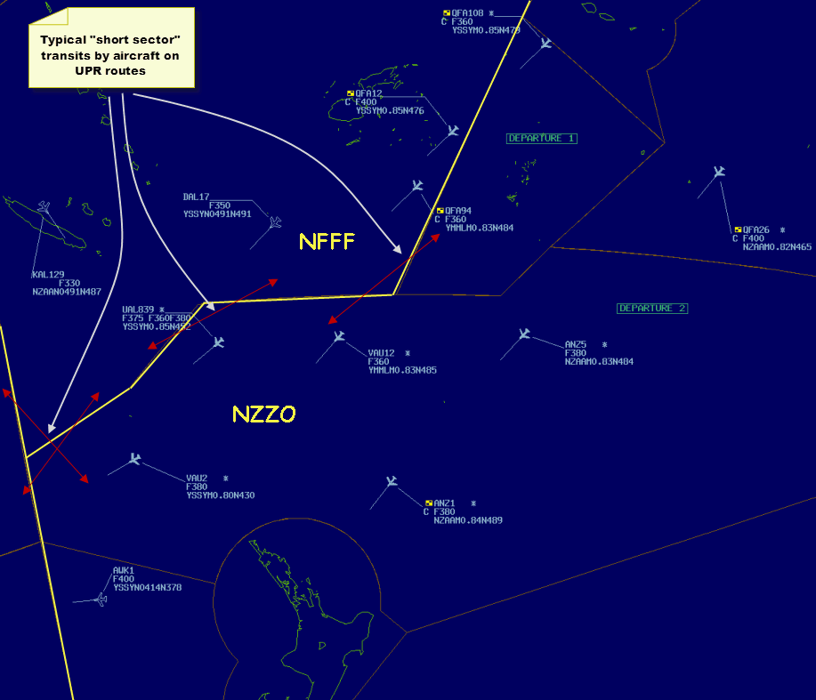
Missing bits of jigsaw – RCP? - RSP?
VDL2?
RNP4
VHF?
POA?
RCP240?
Inmarsat I3?
RCP400?
RNP4
Inmarsat I4?
SATCOM?
RNP4
RNP4
Iridium?
RNP4
RSP180?
RNP from FPL
RSP400?
MTSAT?
RNP4
RNP4
HFDL?
RCP/RSP from ?
RNP104
SATCOM +HFDL?

Slide 6
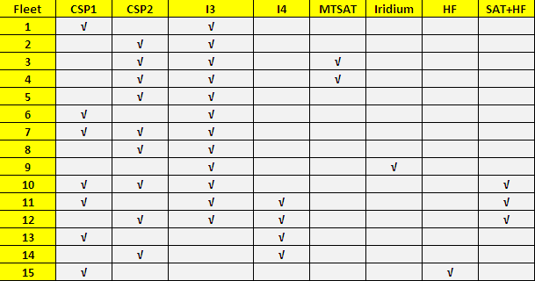
Different implementations = Different performance

Slide 7
RSP/RCP – ICAO 2012 FPL
Currently, there is potential for an ANSP to misapply Air Traffic Services to an operator or aircraft type.
Current amendment to Doc4444 for FPL 2012 makes provision for RCP allocation in Field 10 but does not assign values to the designators. No similar provision was made for RSP allocation in Field 10 but does mention use of SUR/ in Field 18.
OPLINKP have agreed that in ICAO FPL:
  For RCP Field 10a - P1=RCP240 and P2 = RCP400
  For RSP Field 18 use SUR/RSP180 or SUR/RSP400
Consider a Doc7030 amendment to mitigate this issue?

Slide 8
ANSP – Ground System Automation
With proliferation of different aircraft equipment, technology, and wide variations in observed performance, there is an urgent need for improved ground system automation.
While some guidance is provided in the GOLD 3.1.2 additional guidance is required in the area of ground system automation that will assist controllers to enable benefits. Some areas under consideration:
  Mitigate risk of inadvertent application of D50/D30 to RNP qualified aircraft that do not qualify by filed/ observed RSP/RCP using system interlocks.
  Improved controller HMI

Slide 9
ANSP – Supporting infrastructure
Implementing FANS1/A CPDLC and ADS-C in isolation without considering the supporting infrastructure will restrict/delay operational benefits:
  In Oceanic/Remote airspace significant benefits can be realised through DARP. DARP requires AIDC to communicate route changes to downstream ANSP. No AIDC = No DARP.
  Recent I3 failure 22 October 2011 in Pacific is a good example where supporting infrastructure could do better.

Slide 10
Supporting infrastructure – NZZO case study
A 910 minute outage of the Inmarsat POR satellite occurred at 0900 UTC on 22 October
    NZZO received SITA notification of failure at 0939 UTC
    NZZO received ARINC notification of failure at 1248 UTC
At 08:54UTC the on-board Frequency Generation System switched off unexpectedly causing a total Payload outage. This is classified as a rare Single Event Upset (SEU) by Inmarsat
NZZO observed Inmarsat contingency arrangements commence using the I2 satellites at 1956UTC via AOE2 Perth and XXC Santa Paula
I do not believe any ANSP has seen a final report on this outage detailing lessons learnt and areas for improvement. Feedback and communication are at the core of any performance based system.

Slide 11
Supporting infrastructure – NZZO case study
Eight aircraft were operating FANS1/A at time of failure:
  1 B772 MTSAT – unaffected
  1 B744 SITA POR1 switched to MTSAT – unaffected
  1 military operating Arinc XXC switched to HFDL
  1 A340 operating Arinc XXC switched to AOW via XXE - unaffected
  2 B744 operating Arinc XXC lost data-link
  1 A388 operating SITA POR1 switched to HFDL
  1 B744 operating SITA POR1 lost data-link
During the failure period:
  A332 and A388 normally operating HFDL in “next on busy” mode operated HFDL. Only 1 CPDLC transaction with ACP 201 seconds, 16 ADS-C downlinks with only 75% meeting RSP400 95% 300” and 81% meeting RSP400 99.9% 400”
  A388 operating Inmarsat I4 unaffected
  B772/B744 operating MTSAT unaffected

Slide 12
Supporting infrastructure – NZZO case study
Some food for thought:
  The small number of aircraft that appear to have MTSAT configured in their ORT’s
  Why can’t aircraft switch I3 to I4?
  Observed HFDL performance poor
  Nearly six months after the event still no final report:
    what are lessons learnt?
    what can be improved?

Slide 13
GOLD – Global Operational Data-link Manual
A significant step towards global standard procedures:
  Appendix B & C provides guidance on RCP and RSP performance specifications.
  Appendix D provides guidance on post implementation monitoring and corrective action.
  Chapter 4 provides Controller procedures
  Chapter 5 provides Flight Crew procedures
While adopted by ANPANPIRG it is still an important work in progress.

Slide 14

Thank you
Paul Radford
Manager Oceanic Systems
Airways New Zealand paul.radford@airways.co.nz

